Slide 1

Arduino Workshop
Hosted by: Gustavo Correa and Gian Ocampo
Location: Creat’R Lab @ UCR
Today’s Date: April 25th, 2017
Schedule: Weekly, 4/25/17 - 5/30/17
Slideshow link: http://bit.ly/ArduinoWorkshopSlides

Slide 2
About me!
My name is Gian Ocampo
3rd Year Computer Engineering student
I love Pineapple on Pizza
Micromouse
Next Year’s Robotics Coordinator
JOIN MICROMOUSE!!!!!

Slide 3
Overview
Workshop Update
What is Arduino??
What can you do with Arduino?
Review of last workshop
Using a Button to control LED brightness
Using Infrared Emitter/Sensor to control LED brightness
Challenge Activity!

Slide 4
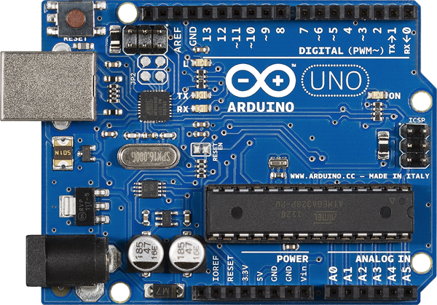
Workshop Update
For next week's workshop we are going to have “open hours”!
We will be demoing new sensors at the beginning of the workshop
Feel free to borrow any of the equipment and create a project during open hours
Or come in with an idea or project that you need help with!

Slide 5
Sooo what can I do with it??

Slide 6
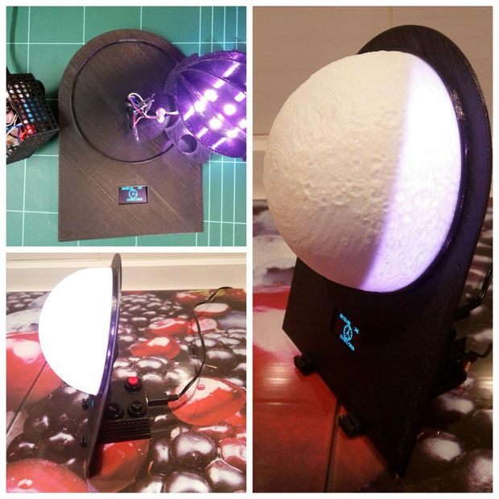
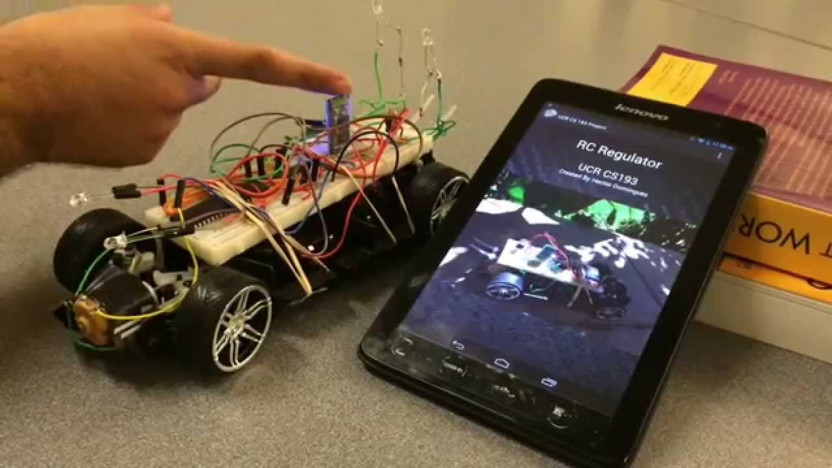
What can you do with Arduino?
Robots
Hackathon projects
Class Projects
Interactive Art

Slide 7
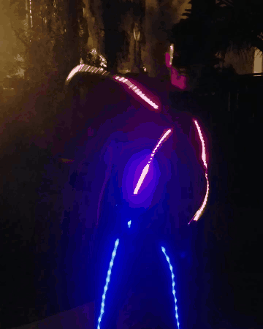
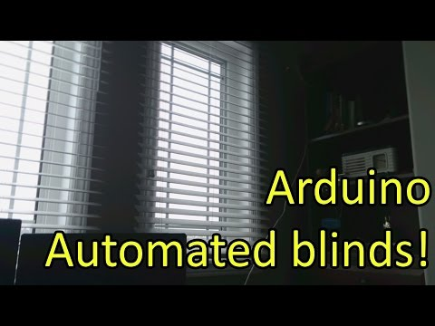
What else can you do with Arduino??
Internet of Things and Home Automation
Robots - Micromouse
Costumes/Wearables

Slide 8

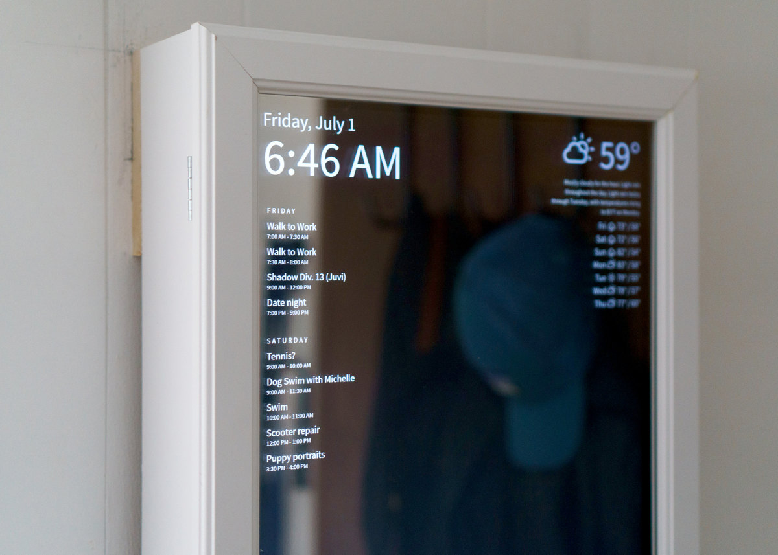
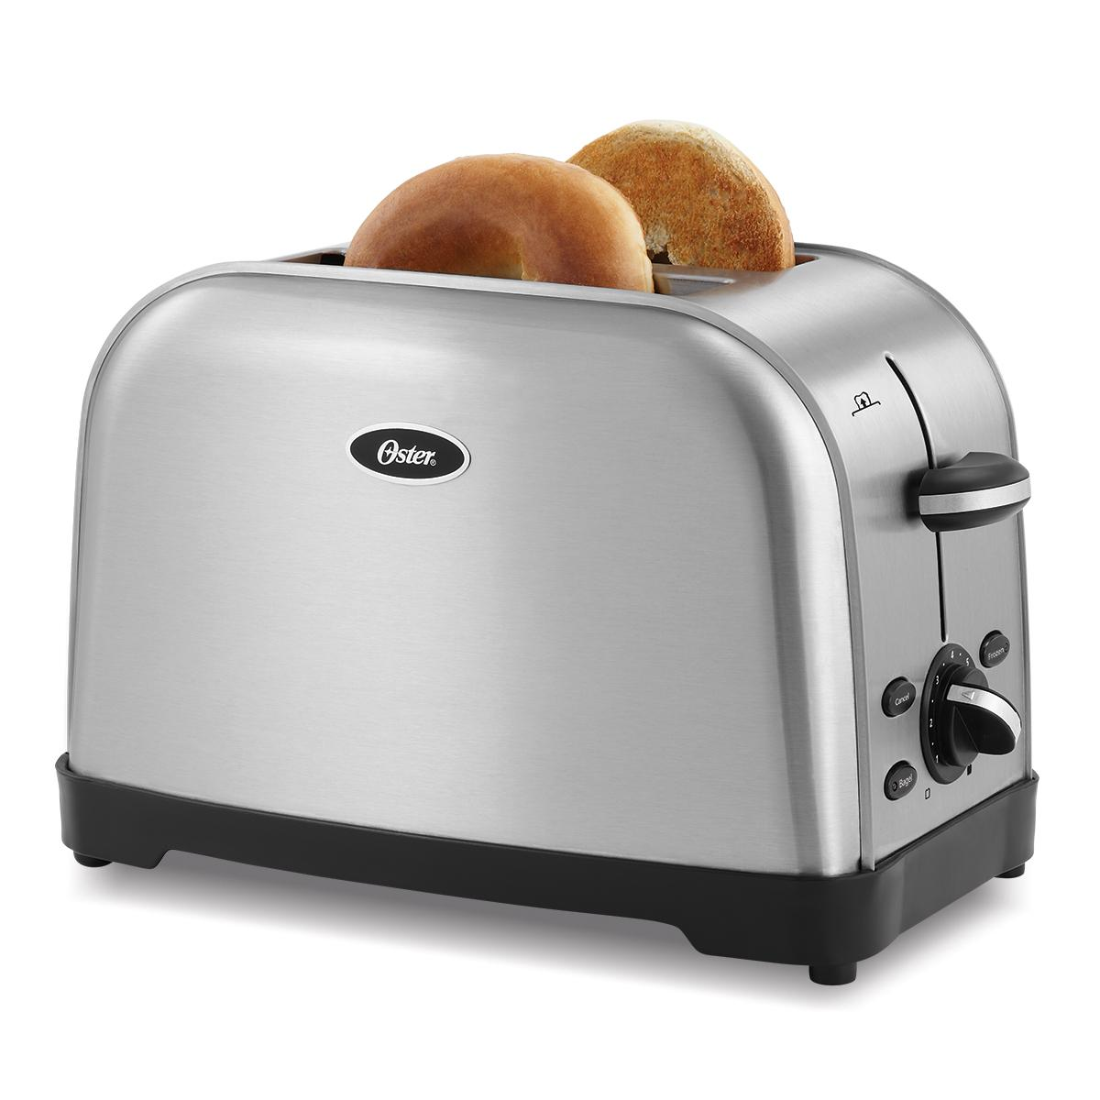
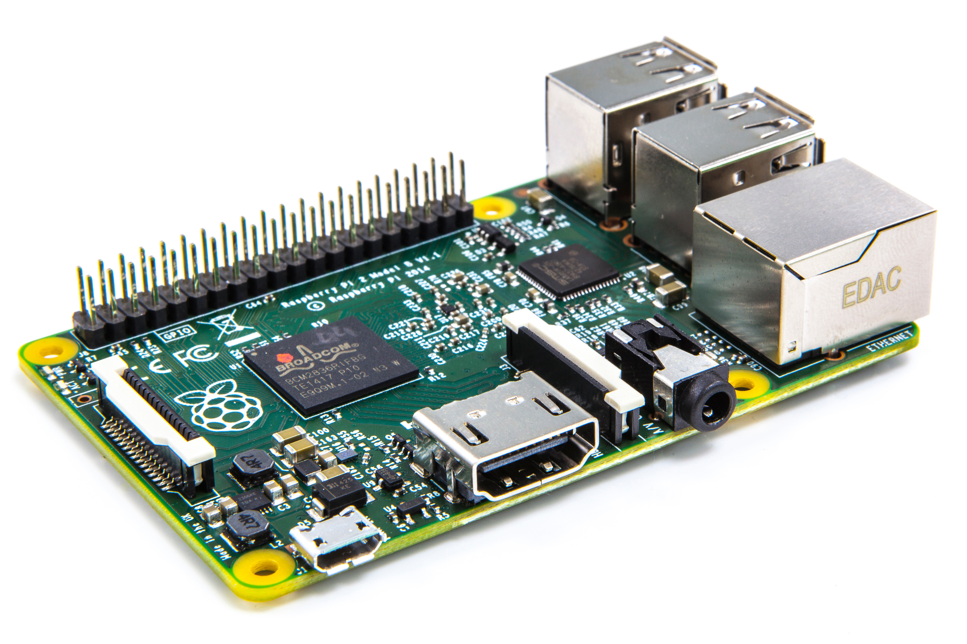
Connect the Arduino to more things to make more cool stuff!
Make a smart mirror to control a toaster !

Slide 9
Let’s Review!

Slide 10
Terminology
“Sketch” - program that runs on the board
“Pin” - input or output connect to something
ex) Output to an LED, input from a switch
“Digital” - 1 is High, 0 is Low
“Analog” - range of values (0 - 255 typically)

Slide 11
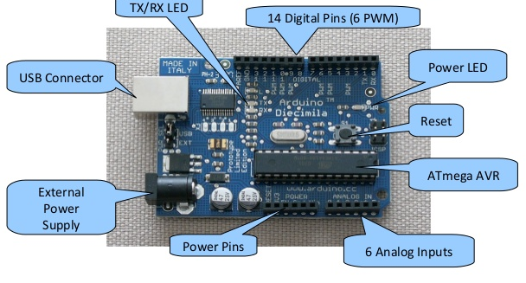
Hardware parts of an Arduino

Slide 12
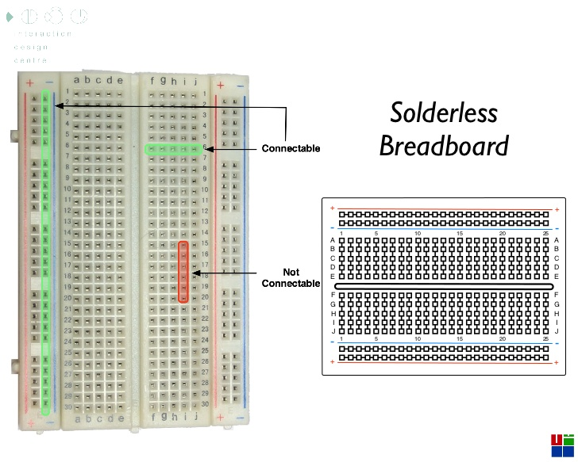
What is a Breadboard?

Slide 13
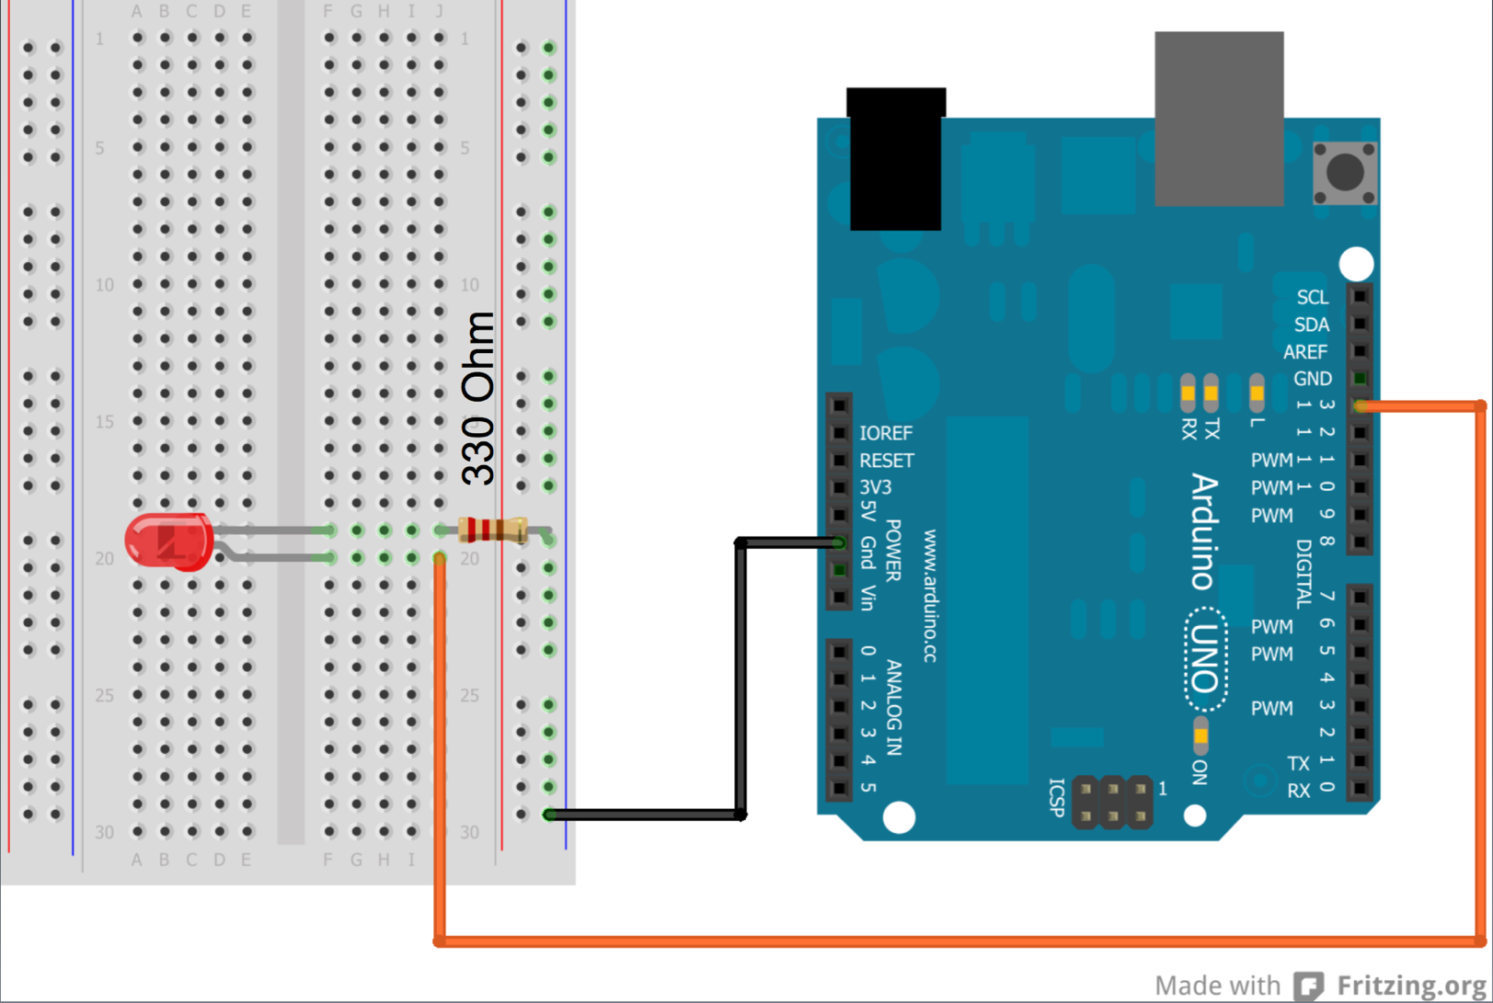
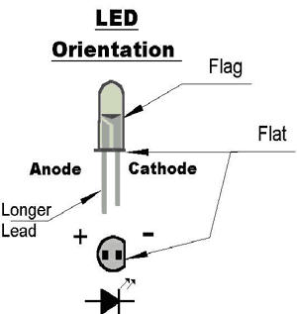
Wiring
Short end
Long end

Slide 14
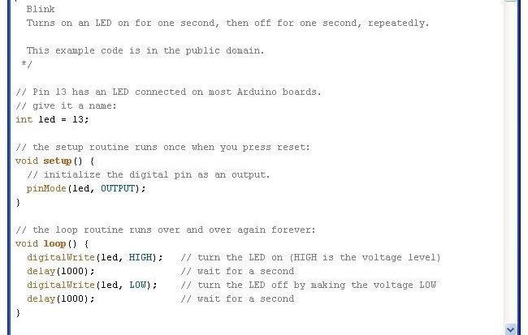

Slide 15
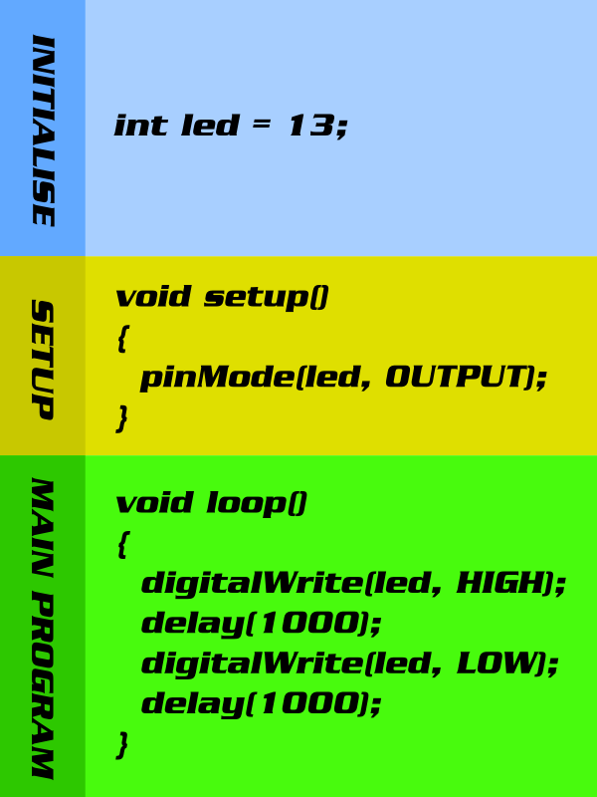

Slide 16
What’s going on in the code??

Slide 17
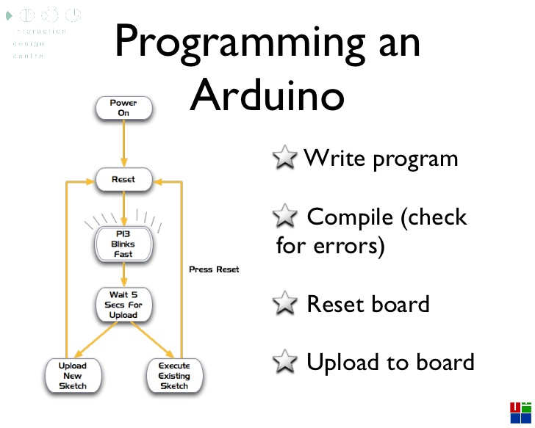

Slide 18
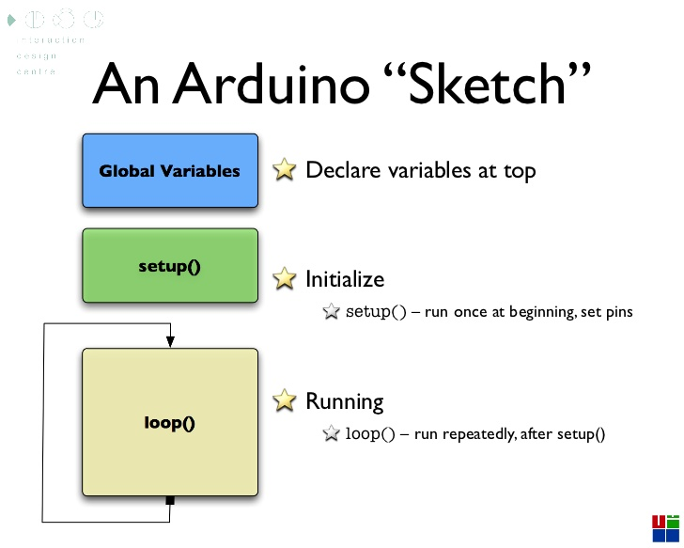

Slide 19
What are variables?

Slide 20
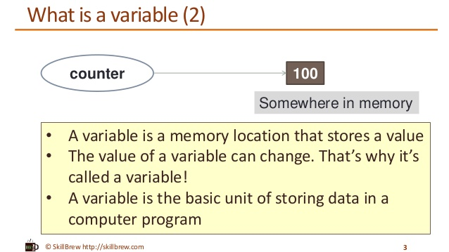

Slide 21
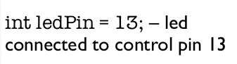
Parts to a variable
Data type
Variable Name
Value

Slide 22
What are functions?

Slide 23
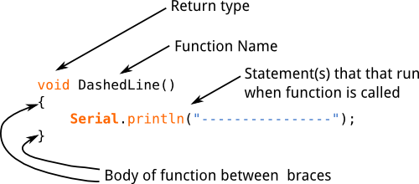
Parts to a function

Slide 24
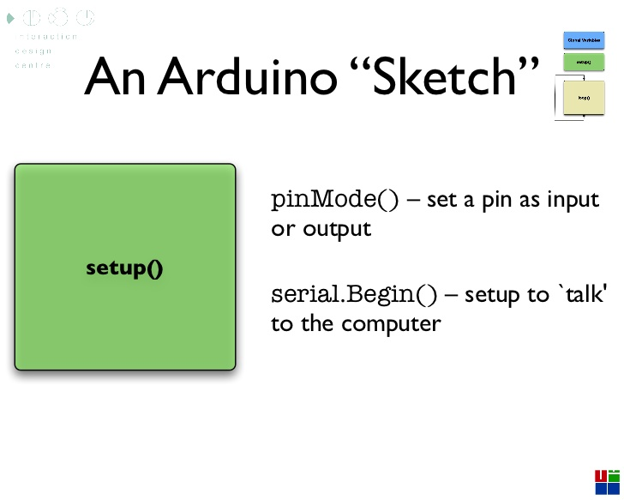
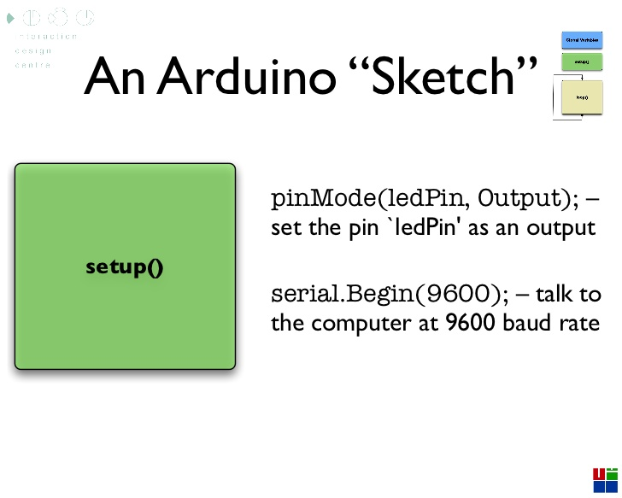

Slide 25
Using a Button to Turn on an LED

Slide 26
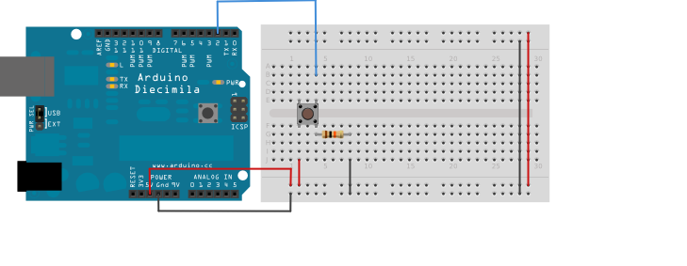
Wiring

Slide 27
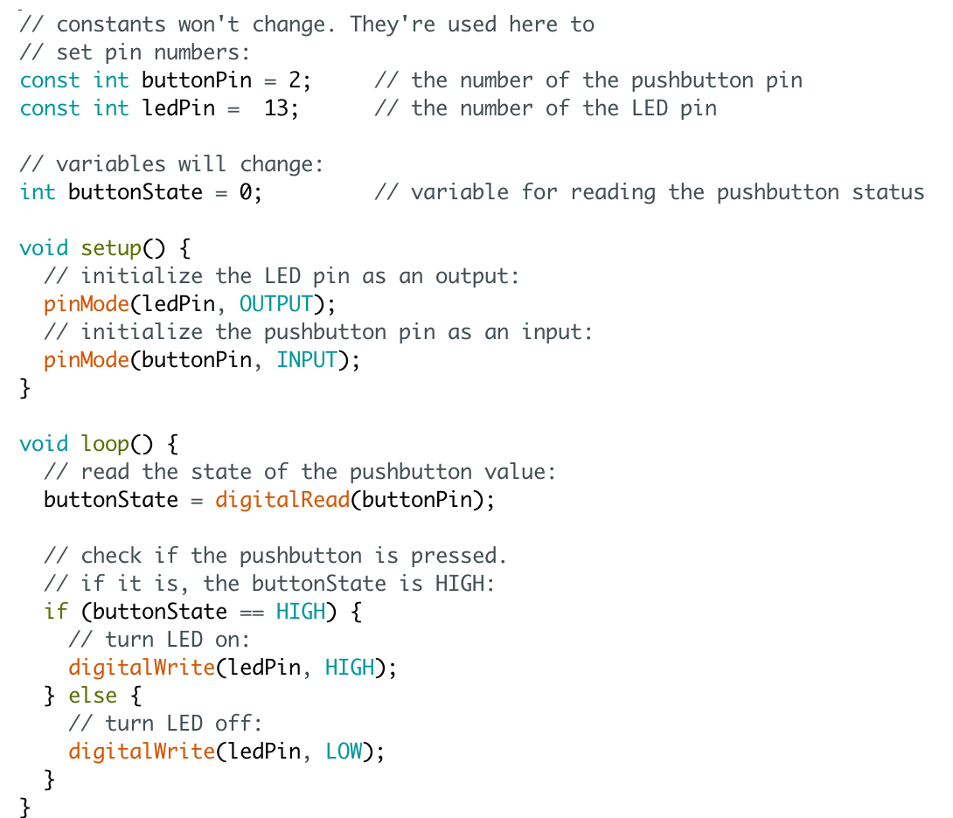
The code!

Slide 28
Infrared Emitter/Sensor Project!

Slide 29
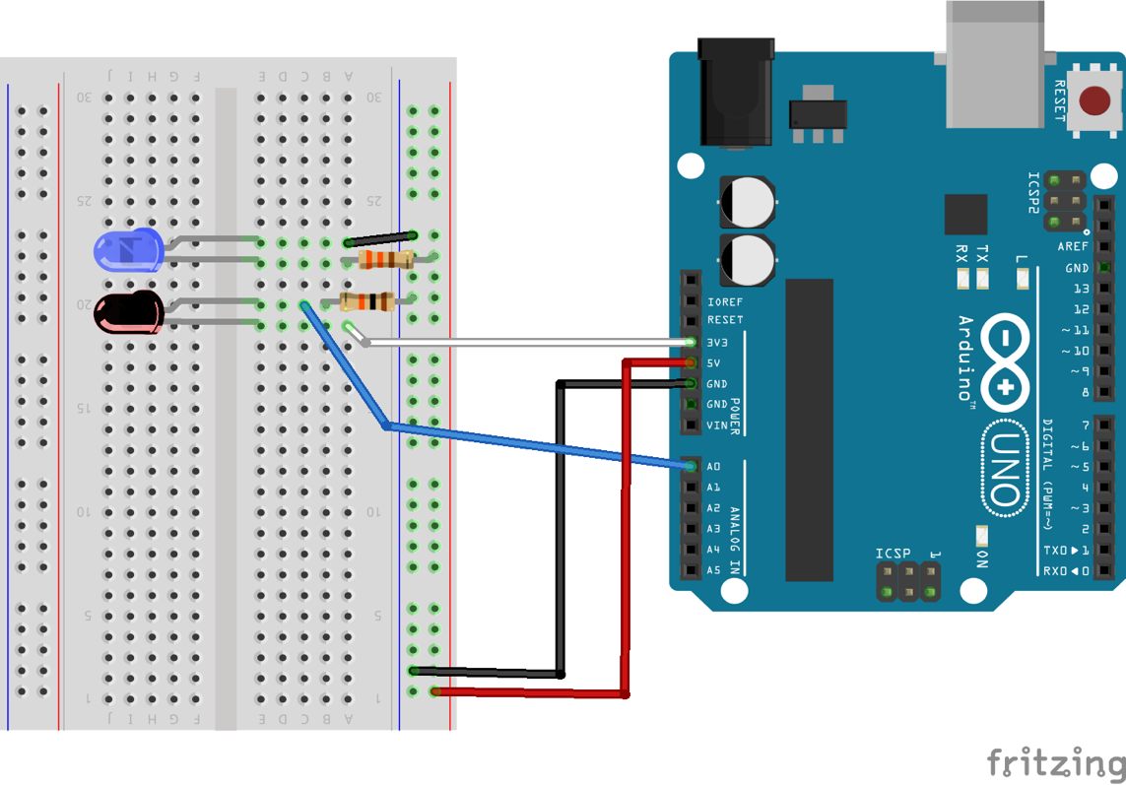
Wiring
Long end (with bent)
Long end is positive (+)
Short end is negative (-)
Short end

Slide 30
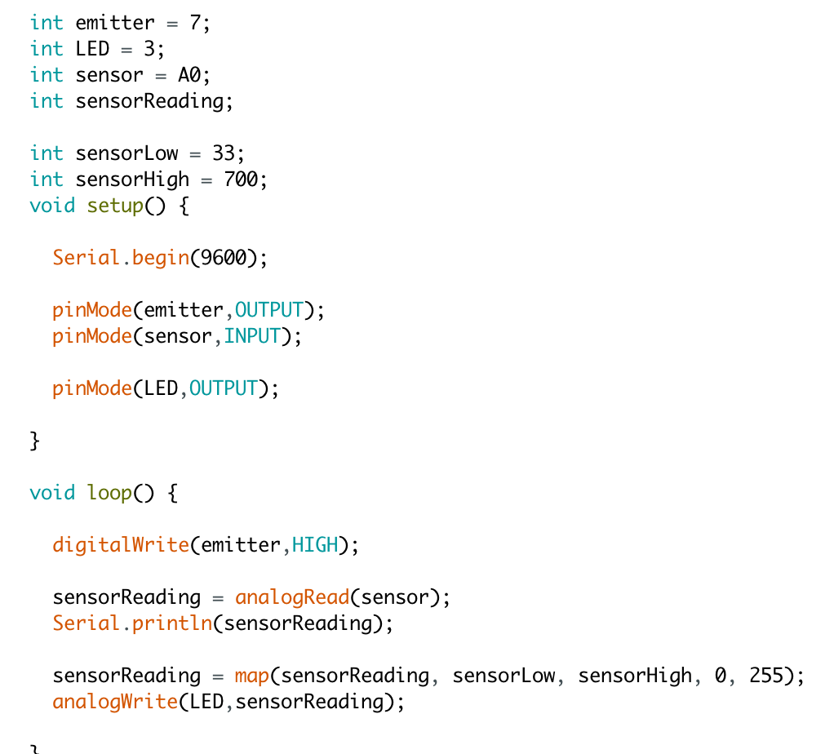
The code!

Slide 31
MINIPROJECT !!!

Slide 32
Project Description
Write a sketch to decrement LED brightness with a button
Put the code in a function
Call the function in the void loop() function
Let’s go to the Arduino IDE!

Slide 33
Done!!!
Next workshop date:
Tuesday May 9th
Thanks for coming!!!

